Slide 1
From financial to political risk? Lessons from French experience of pension reforms
Samia BENALLAH Université de Reims Champagne-Ardenne, Regards
Workshop on "Pension Funding and Risk Management" 28 June 2018

Slide 2
Purpose of the presentation
Give an overview of the effects of pension reforms on retirement behavior
3 parts:
The original issue: unsustainability of Pay-As-You-Go pension systems
Reforms and their (expected) effects
Political risk: a new issue?

Slide 3
The original issue

Slide 4
Financial context of Pay-As-You-Go systems
Financial balance of the pension system :
Contributions = Benefits

Slide 5
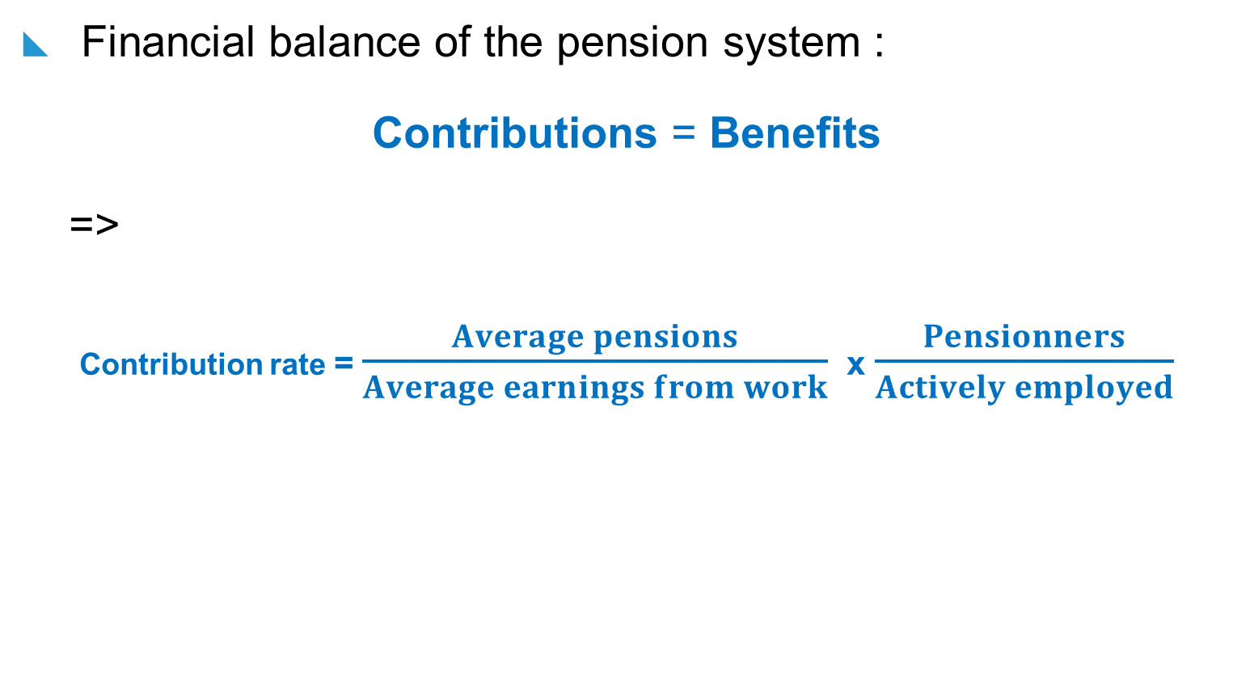
Financial context of Pay-As-You-Go systems

Slide 6
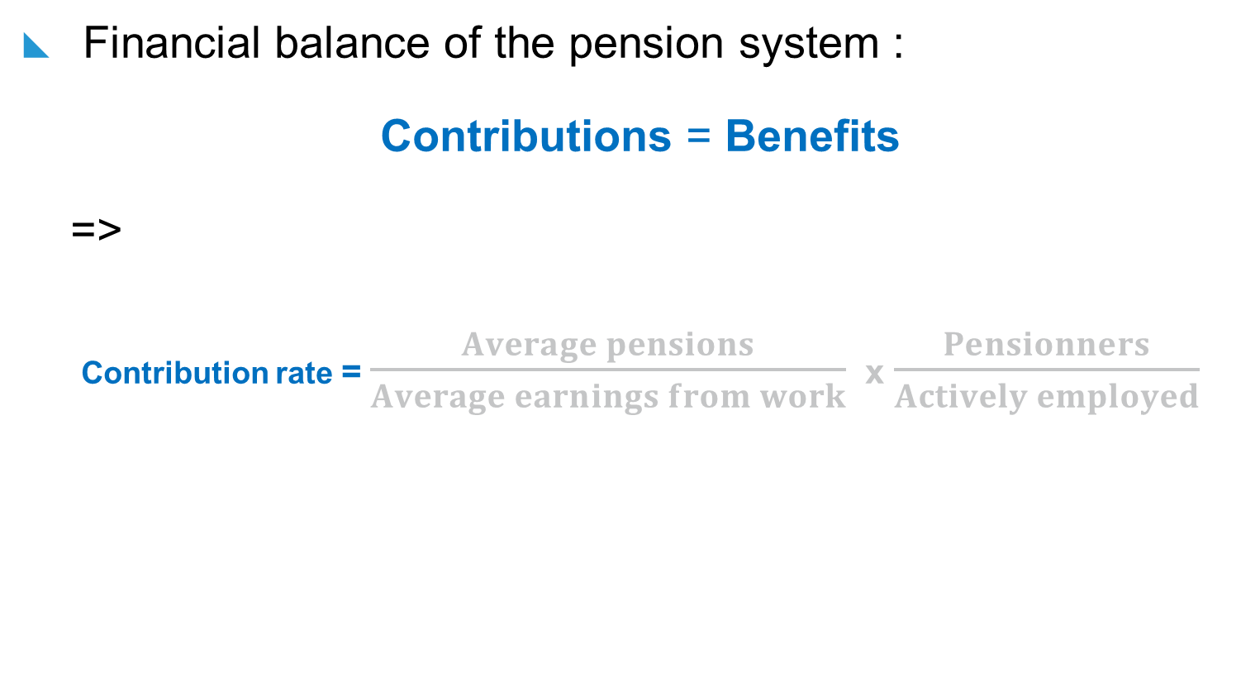
Financial context of Pay-As-You-Go systems
Labour taxation

Slide 7
Financial context of Pay-As-You-Go systems
Labour taxation

Slide 8
Financial context of Pay-As-You-Go systems
Wage replacement rate

Slide 9
Financial context of Pay-As-You-Go systems
Wage replacement rate

Slide 10
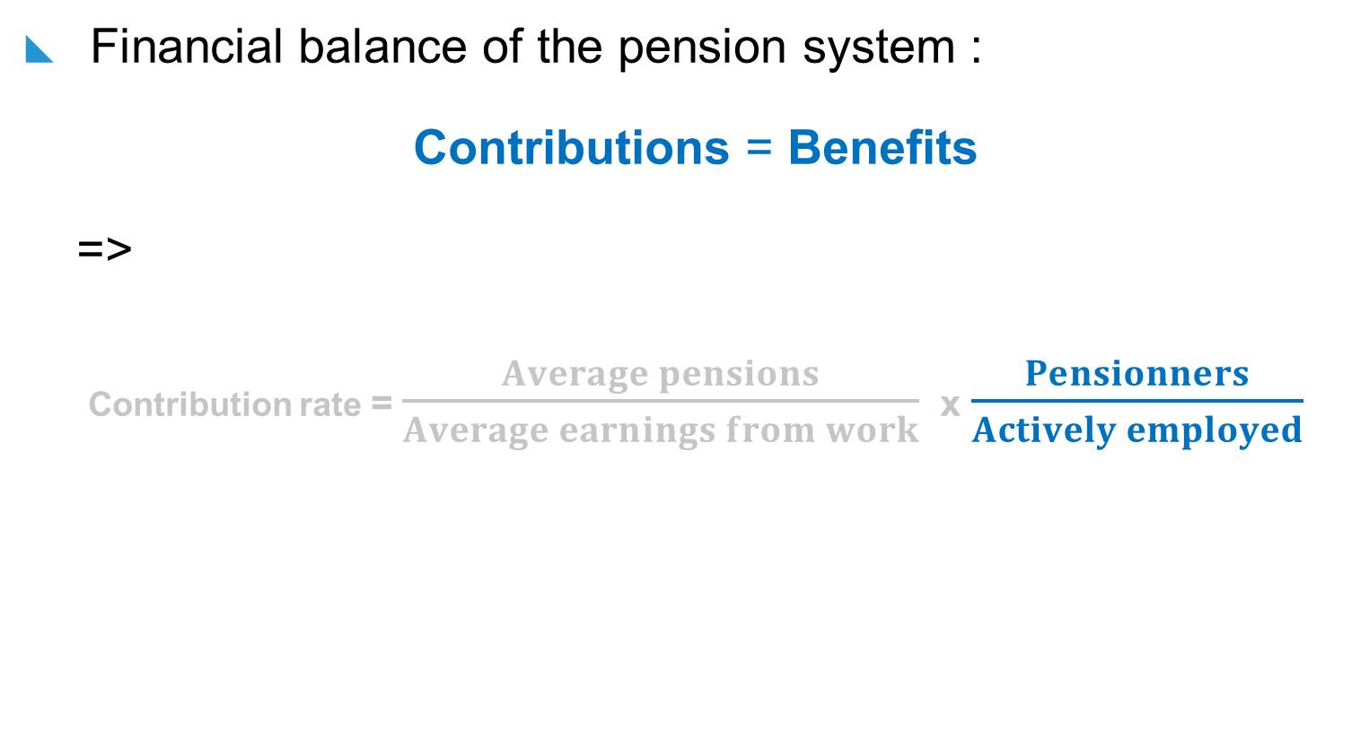
Financial context of Pay-As-You-Go systems
Old-age dependency ratio

Slide 11
Financial context of Pay-As-You-Go systems
Old-age dependency ratio

Slide 12
Financial context of Pay-As-You-Go systems
Incentives to delay retirement

Slide 13
Reforms and their effects
The French case

Slide 14
Reforms concerning the retirement age
2010 : A higher minimum age for retirement : 60 → 62
2010 : A higher legal age for retirement : 65 → 67
1993, 2003, 2014 : A higher length of contribution to obtain a full pension : 37,5 years → 43 years
2003 → 2009 : Creation of the “surcote”: + 3% per year → 5% per year

Slide 15
Reforms concerning the level of pensions
Basic schemes:
Number of best annual wages taken into account for the pension : 10 → 25
Indexing pensions and pensionable wages : Growth rate of the average wage in the economy → Inflation
Supplementary schemes:
Lower points returns since 1990s
Indexing pensions : Growth rate of the average wage in the economy → Inflation

Slide 16
Effects of these reforms (1/5)
Median replacement rate, by generation
Marino (2014) - INSEE

Slide 17
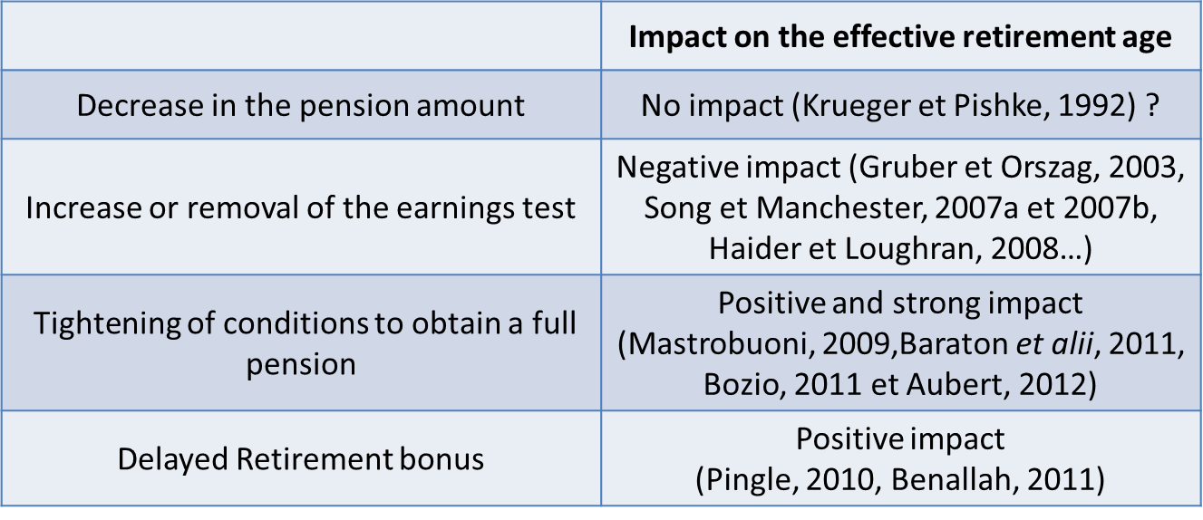
Effects of these reforms (2/5)
What elasticity of elderly labour-supply to pensions ?

Slide 18
Effects of these reforms (3/5)
Age of retirement
DREES (2018)

Slide 19
Effects of these reforms (4/5)
Employment rate of older people (55-64 years)
Minni (2015) - INSEE

Slide 20
Effects of these reforms (5/5)
Public expenditure on pensions (% of GDP)
Marino (2014) - INSEE

Slide 21
What unsettled issues?

Slide 22
A higher retirement age: at what a price?
Other factors affecting retirement decisions : working conditions and health
From the beginning of the career /
Delayed effects on health and life expectancy
Entry
Retirement
Career
End of career /
« Immediate desutilty of work »

Slide 23
A higher retirement age: at what a price?
Wind et alii (2013)
The « Compte pénibilité » : an imperfect (ineffective?) solution
Poor health
Decline in ability to work
Painful working conditions
Fear of health deterioration
Pressure from the employer
Early retirement

Slide 24
A higher retirement age: at what a price?
What do young people think about retirement age?
Aubert (2013)

Slide 25
A pension legislation unreadable?
Imperfect knowledge of Social Security and pensions
Bridenne (2006), Benallah (2012), Arrondel et alii (2013)
Gustman et alii (2007), Chan et Stevens (2008), Mastrobuoni (2011),
Reforms have hindered the predictability of the amount of pension
Aubert (2014)
Fear of new reforms is a determinant of retirement decisions
Aubert (2016)

Slide 26
Conclusive remarks
Demographic challenge raised
Other Pay-As-You-Go pension systems goals: welfare, need of security (Davanne and Pujol, 1997)
Political risk (Shoven and Slavov, 2005) = “variation in internal rates of return promised to Social Security participants under the law”. = “variation in replacement rates”
Another (systemic) reform coming without “education” on past reforms
Much worry expressed about the future of French pension system (Arrondel et alii, 2013)

