Slide 1
How parametric adjustments may reduce risks in a PAYG pension system? The French case
Angers, 27 June 2018
Anne Lavigne
Secrétariat général du COR

Slide 2
Outline
Role of pension systems in dealing with risks
Pension systems as insurance providers
PAYG pension systems and computing pension rights: are there differences in their abilities to deal with risks?
Focus on the French pension system and the last projections by COR

Slide 3
What are the main roles of a pension system?
Providing insurance against longevity risk
Aging: alteration of mental, cognitive and physical abilities/capabilities
Certainty vs. uncertainty in aging
Pension systems and risks
Intertemporal consumption smoothing; imperfect information and behavioral biases → private saving vs. mandatory pension system → state paternalism + negative externalities if too high time preference
Longevity risk: uncertainty about lifetime; uncertainty about careers and earnings; uncertainty about spending at oldest ages → pension systems provide insurance against those risks (individuals outliving assets accumulated to finance retirement)
Pension systems and redistribution
Intergenerational and intragenerational redistribution

Slide 4
Pension systems as insurance providers
Question of risk sharing/transfer: who bear the risk(s) of providing a pension income at retirement?
Risks
Longevity risk
Demographic risks
Economic risks: growth, inflation, interest rate (in a nutshell “r” and “g”
Political risks: social ‘pact’ (protecting ‘creditors’: those who have a claim on future outcome) vs. property (protecting ‘shareholders’: those who have a property right on future outcome)
Spectrum of risk sharing
Risks borne individually
Risks shared collectively among members
Risks shared between members and pension providers
Risks fully transferred to providers

Slide 5
PAYG pension systems and risks mitigation
PAYG
DB arrangements
Promise to pay an annuity → no risk withheld by individuals?
Remaining risks borne by individuals
For contributors
Changes in the parameters used to compute pensions
Political risks (from PAYG to funded schemes; from mandatory to voluntary schemes)
For retirees
Changes in indexation rules of pension

Slide 6
Annuity-based, point-based and NDC arrangements
Annuity-based
Valorisation: adjustment of past earnings to account for changes in living standards between the time when pension rights are earned and when they are claimed
Indexation: adjustment of pensions during the retirement period
Wage/wage, wage/price, price/price → sensitivity of the replacement rate (or standard of living at retirement) to growth (GDP, labor productivity) → ‘social pact’: should retirees benefit from productivity gains?
Steering annuity-based PAYG systems:
Lots of levers
Discretion vs. automatic balance
Overall risk of longevity: to be dealt by using the contributory record to get full pension (indexing the contributory record to life expectancy – as done in the 2003 Law)

Slide 7
Annuity-based, point-based and NDC arrangements
Point-based
Same story as annuity-based schemes but
Valorisation of points (eg Germany)
Indexation of pension
Steering point-based PAYG systems
Basically one lever (technical rate of return)
Discretion vs. automatic balance
Indexing the value of the point on life expectancy (or a demographic parameter such as population age structure)
NDC
Built-in longevity risk sharing (see Vincent Touzé’s presentation)
But deserves discretionary adjustments to deal with yearly deficits induced by poor economic growth (see Ole Settergren’s presentation)

Slide 8
How about reserves in PAYG systems?
Should PAYG systems build reserves?
Hardly no reserves in France
Minimum and maximum in Germany
Reserves in Sweden
Reserves as
Very short term buffer (delays between contribution collection and pension installments)
Precautionary buffer (short term macroeconomic shocks)
Smoothing demographic cycles → not a question of longevity risk per se but a question of intergenerational risk smoothing

Slide 9
A focus on the French PAYG system

Slide 10
Public spending in the French PAYG (as % of GDP)
14,4 %
13,8 %
13,5 %
13,3 %
12,6 %
11,6 %
Sources : reports to CCSS 2002-2018 ; projections COR – June2018.

Slide 11
Determinants of public spending – average pension
Average gross pension (total retirees) / average gross earnings
Contributors / pensioners
51,2 %
1,7
40,1 %
32,5 %
1,3
Sources : reports to CCSS 2002-2018 ; projections COR – June2018.

Slide 12
The relative average pension
F1
The diminution of the relative average pension means that the average pension increases at a lower pace than the average earnings
Average net pension
Average net earnings
+51%
+144%
+32%
+73%
Sources : DREES, modèle ANCETRE 2009-2016; INSEE, Comptes Nationaux ; projections COR – juin 2018.
1 512 € per month in 2016 ; retirees living in France
2 314 € per month in 2016

Slide 13
Age at pension claiming
F2
The decrease in support ratio would be mitigated by the increase in age at pension claiming
Age at pension claiming
63,9 ans
61,8 ans
Source : projections COR – juin 2018.

Slide 14
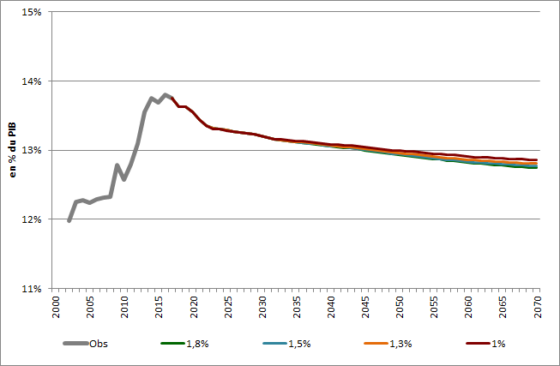
Ressources of the French PAYG (as % of GDP)
13,8 %
12,9 %
12,7 %

Slide 15
Determinants of ressources
Share of civil servant earnings in total earnings (public and private)
Contribution rate
(contributions/total earnings)
11,0 %
31,1 %
9 %
29,2 %
28,9 %
Sources : rapports à la CCSS 2002-2018 ; projections COR – juin 2018.

Slide 16
Projected financial balance of the French PAYG (as % of GDP)
1,1 %
0,2 %
0,0 %
-0,5 %
-1,5 %
Sources : rapports à la CCSS 2002-2018 ; projections COR – juin 2018.

Slide 17
Living standard of retirees (wrt whole population)
Living standard of retirees / living standard of whole population
105,6 %
89,1 %
76,7 %
Sources : projections COR – juin 2018.

Slide 18
Intergenerational equity
Replacement rate (pension/last net wage) for a non-executive private sector worker with full career
With haircut on ARRCO pension
Without haircut on ARRCO pension
Threshold defined by decree
66,7 %
Sources : projections COR – juin 2018.

Slide 19
L’équité entre générations
Replacement rate (pension/last net wage) for a civil servant (middle category) with full career
Stable share of civil service premiums
Increasing share share of civil service premiums
Sources : projections COR – juin 2018.

Slide 20
Internal rate of return (private sector worker)
Source : calculs SG-COR à partir de DREES, modèle CALIPER.
20

Slide 21
Merci de votre attention Thanks for your attention
Suivez l’actualité et les travaux du COR sur www.cor-retraites.fr et twitter @COR_Retraites

